Slide 1
C++ Pattern Programs

Slide 2
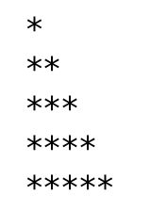
j
 | 1 | 2 | 3 | 4 | 5
1 | *
2 | * | *
3 | * | * | *
4 | * | * | * | *
5 | * | * | * | * | *
i | j
1 | 1
2 | 1,2
3 | 1,2,3
4 | 1,2,3,4
5 | 1,2,3,4,5
i | j
1 | j<=1
2 | j<=2
3 | j<=3
4 | j<=4
5 | j<=5
i
j<=i
Notes:
#include <iostream>
using namespace std;
int main()
{
int i,j;
for(i=1;i<=5;i++)
{
for(j=1;j<=5;j++)
if(j<=i)
cout<<"*";
else
cout<<" ";
cout<<endl;
}
return 0;
}

Slide 3
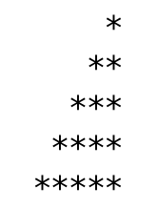
j
 | 1 | 2 | 3 | 4 | 5
1 |  |  |  |  | *
2 |  |  |  | * | *
3 |  |  | * | * | *
4 |  | * | * | * | *
5 | * | * | * | * | *
i | j
1 | 5
2 | 4,5
3 | 3,4,5
4 | 2,3,4,5
5 | 1,2,3,4,5
i | j
1 | j>=5
2 | j>=4
3 | j>=3
4 | j>=2
5 | j>=1
i
j>=6-i
Notes:
#include <iostream>
using namespace std;
int main()
{
int i,j;
for(i=1;i<=5;i++)
{
for(j=1;j<=5;j++)
if(j>=6-i)
cout<<"*";
else
cout<<" ";
cout<<endl;
}
return 0;
}

Slide 4
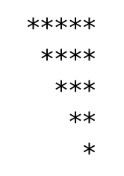
j
 | 1 | 2 | 3 | 4 | 5
1 | * | * | * | * | *
2 |  | * | * | * | *
3 |  |  | * | * | *
4 |  |  |  | * | *
5 |  |  |  |  | *
i | j
1 | 1,2,3,4,5
2 | 2,3,4,5
3 | 3,4,5
4 | 4,5
5 | 5
i | j
1 | j>=1
2 | j>=2
3 | j>=3
4 | j>=4
5 | j>=5
i
j>=i
Notes:
#include <iostream>
using namespace std;
int main()
{
int i,j;
for(i=1;i<=5;i++)
{
for(j=1;j<=5;j++)
if(j>=i)
cout<<"*";
else
cout<<" ";
cout<<endl;
}
return 0;
}

Slide 5
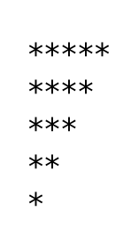
j
 | 1 | 2 | 3 | 4 | 5
1 | * | * | * | * | *
2 | * | * | * | *
3 | * | * | *
4 | * | *
5 | *
i | j
1 | 1,2,3,4,5
2 | 1,2,3,4
3 | 1,2,3
4 | 1,2
5 | 1
i | j
1 | j<=5
2 | j<=4
3 | j<=3
4 | j<=2
5 | j<=1
i
j<=6-i
Notes:
#include <iostream>
using namespace std;
int main()
{
int i,j;
for(i=1;i<=5;i++)
{
for(j=1;j<=5;j++)
if(j<=6-i)
cout<<"*";
else
cout<<" ";
cout<<endl;
}
return 0;
}

Slide 6
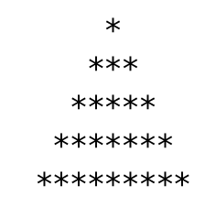
j>=6-i && j<=4+i
j>=6-4 && j<=4+4
j
i | j
1 | 5
2 | 4,5,6
3 | 3,4,5,6,7
4 | 2,3,4,5,6,7,8
5 | 1,2,3,4,5,6,7,8,9
 | 1 | 2 | 3 | 4 | 5 | 6 | 7 | 8 | 9
1 |  |  |  |  | *
2 |  |  |  | * | * | *
3 |  |  | * | * | * | * | *
4 |  | * | * | * | * | * | * | *
5 | * | * | * | * | * | * | * | * | *
i | j
1 | j>=5 && j<=5
2 | j>=4 && j<=6
3 | j>=3 && j<=7
4 | j>=2 && j<=8
5 | j>=1 && j<=9
i
Notes:
#include <iostream>
using namespace std;
int main()
{
int i,j;
for(i=1;i<=5;i++)
{
for(j=1;j<=9;j++)
if(j>=6-i && j<=4+i)
cout<<"*";
else
cout<<" ";
cout<<endl;
}
return 0;
}

Slide 7

j>=6-i && j<=4+i && k
j
i | j
1 | j>=5&& j<=5&&k
2 | j>=4&& j<=6&&k
3 | j>=3&& j<=7&&k
4 | j>=2 && j<=8&&k
5 | j>=1 && j<=9 &&k
 | 1 | 2 | 3 | 4 | 5 | 6 | 7 | 8 | 9
1 |  |  |  |  | *
2 |  |  |  | * |  | *
3 |  |  | * |  | * |  | *
4 |  | * |  | * |  | * |  | *
5 | * |  | * |  | * |  | * |  | *
i | j
1 | 5
2 | 4,6
3 | 3,5,7
4 | 2,4,68
5 | 1,3,5,7,9
i
Notes:
#include <iostream>
using namespace std;
int main()
{
int i,j,k;
for(i=1;i<=5;i++)
{
k=1;
for(j=1;j<=9;j++)
if(j>=6-i && j<=4+i && k)
{
cout<<"*";
k=0;
}
else
{
cout<<" ";
k=1;
}
cout<<endl;
}
return 0;
}

Slide 8
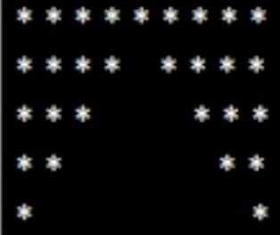
j<=3 || j>=7
j
j<=6-i || j>=4+i
i | j
1 | 1 to 9
2 | 1to4 & 6to9
3 | 1to3 & 7to9
4 | 1,2 & 8,9
5 | 1,9
i | j
1
2 | j<=4 || j>=6
3 | j<=3 || j>=7
4 | j<=2 || j>=8
5
 | 1 | 2 | 3 | 4 | 5 | 6 | 7 | 8 | 9
1 | * | * | * | * | * | * | * | * | *
2 | * | * | * | * |  | * | * | * | *
3 | * | * | * |  |  |  | * | * | *
4 | * | * |  |  |  |  |  | * | *
5 | * |  |  |  |  |  |  |  | *
i
Notes:
#include <iostream>
using namespace std;
int main()
{
int i,j,k;
for(i=1;i<=5;i++)
{
//k=1;
for(j=1;j<=9;j++)
if(j<=6-i || j>=4+i)
{
cout<<"*";
//k=0;
}
else
{
cout<<" ";
//k=1;
}
cout<<endl;
}
return 0;
}

Slide 9
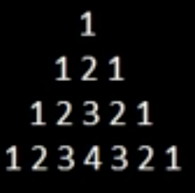
j
 | 1 | 2 | 3 | 4 | 5
1
2
3
4
5
i | j
1
2
3
4
5
i | j
1
2
3
4
5
i
j
Notes:
#include <iostream>
using namespace std;
int main()
{
int i,j,k;
for(i=1;i<=4;i++)
{
k=1;
for(j=1;j<=7;j++)
if(j>=5-i && j<=3+i)
{
cout<<k;
//k=0;
j<4?k++:k--;
}
else
{
cout<<" ";
//k=1;
}
cout<<endl;
}
return 0;
}

Slide 10
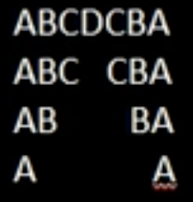
j<=5-i || j>=3+i
j
k<4 -> k++, k--
 | 1 | 2 | 3 | 4 | 5 | 6 | 7
1 | A | B | C | D | C | B | A
2 | A | B | C |  | C | B | A
3 | A | B |  |  |  | B | A
4 | A |  |  |  |  |  | A
i | j
1 | 1 to 7
2 | 1to 3, 5to7
3 | 1,2 and 6,7
4 | 1,7
i | j
1 | j<=4 || j>=4
2 | j<=3 || j>=5
3 | j<=2||j>=6
4 | j<=1||j>=7
i
Notes:
#include <iostream>
using namespace std;
int main()
{
int i,j;
char k;
for(i=1;i<=4;i++)
{
k='A';
for(j=1;j<=7;j++)
if(j<=5-i || j>=3+i)
{
cout<<k;
//k=0;
j<4?k++:k--; //
}
else
{
cout<<" ";
if(j==4)
k--;
//k=1;
}
cout<<endl;
}
return 0;
}

Slide 11

j>=5-k && j<=3+k
j
 | 1 | 2 | 3 | 4 | 5
1
2
3
4
5
i | j
1
2
3
4
5
i | j
1
2
3
4
5
i
Notes:
#include<iostream>
using namespace std;
int main()
{
int i, j, k =0, rows,n;
cout<<"Enter number of rows";
cin>>rows;
n = (rows+1)/2;
for (i=1; i<=rows; i++)
{
if(rows%2==0)
{
if(i<=n)
{
k++;
if(i>n+2)
{
k--;
}
}
}
else
{
i<=n?k++:k--;
}
for (j=1; j<=rows; j++)
{
if (j>=n+1-k && j<=n-1+k)
{
cout<<"*";
}
else
{
cout<<" ";
}
}
cout<<endl;
}
}

Slide 12
More Practice

Slide 13
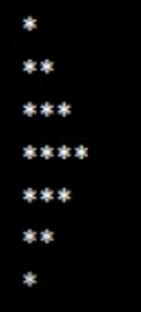
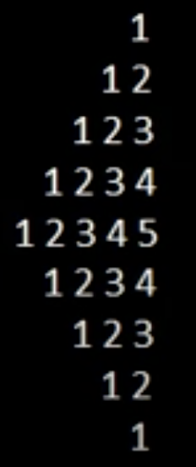
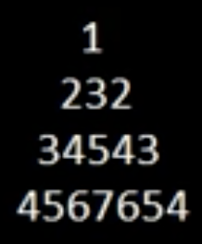
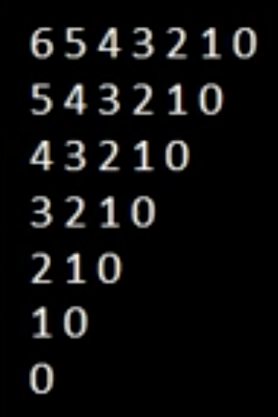

Slide 14
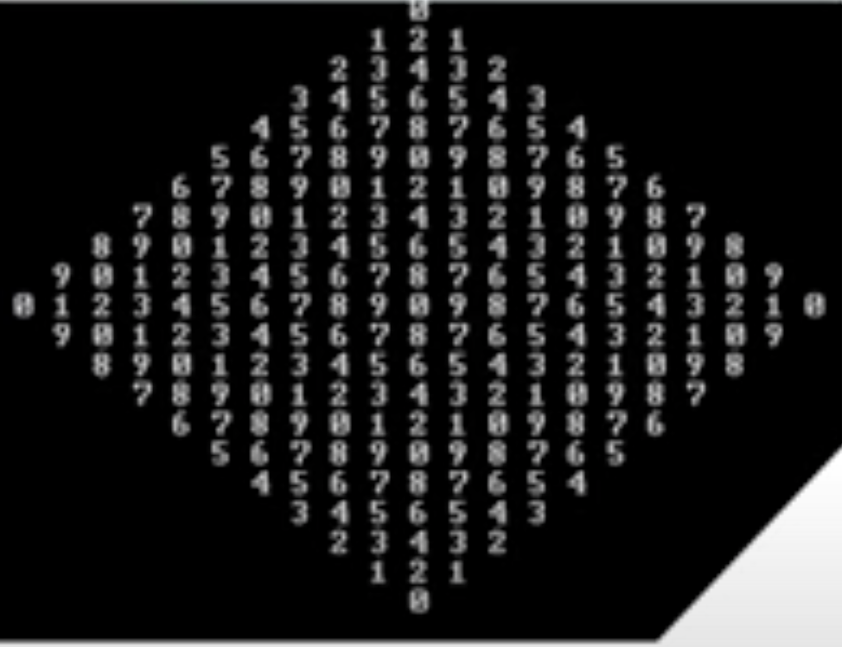

Slide 15
